Slide 1
CTD
Postgre SQL
Red is the developed system
gray is third-party application
CAS
LDAP
1、CTD using the PostgreSQL as database.
2、CTD use the CAS for user authentication.

Slide 2
CTD Server Architecture
CTD Server
CAS Server
CAS Filter \ EnvFilter \ Resteasy Filter
Service/Servlet
Utils\Environment
Logic Accessor
AOP Framework
Param Checker
Security Checker
Excel Reporter
Data Accessor
Ldap Accessor
DB
Ldap Server
1、Using the resteasy framework to support the RESTful API.
2、AOP framework was written by myself, it will be explained in the next page.
3、I have written a utility class which making the properties file mapped to Java entity.

Slide 3
AOP Framework
Invoke
Target Method
(Annotated with @Extend)
The method (which has add @Extend annotation) invoke process as bellow.
Invoke
InvokeFilter A
InvokeFilter B
InvokeFilter C
……
Target Method
* The code which has realized the AOP specification can be found in following JAVA package:
tools.ctd.aop

Slide 4


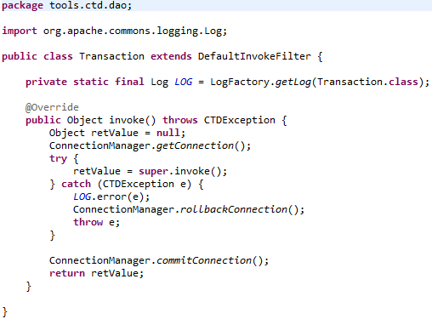
AOP Framework Example
1. Annotates the mehod with @Extend.
2. Annotates the class with @Extend, that is same as annotates all public method in class.
3. The following is the code of Transaction class, it is simplely.
Invoke the next InvokeFilter
The @Extend annotation can receive an InvokeFilter array, it will be processed one by one.
The InvokeFilter can hijack the real implementation.

Slide 5
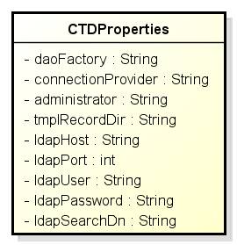
JAVA-Properties Mapping
config.properties
ctd.ldap.host=mpc-auth.neusoft.com
ctd.ldap.port=389
ctd.ldap.user=cn=zhangyw,ou=people,dc=neusoft,dc=internal
ctd.ldap.password=
ctd.ldap.search.dn=cn={userid},ou=people,dc=neusoft,dc=internal
Mapped
@Properties(value="config.properties")
public class CTDProperties {
……
public int getLdapPort() {
return ldapPort;
}
@Property(key="ctd.ldap.port", defaultValue="389")
public void setLdapPort(int ldapPort) {
this.ldapPort = ldapPort;
}
……
}
Use example:
CTDProperties props = CoreProperties.getProperties(CTDProperties.class);
Int port = props.getLdapPort();
……

Slide 6
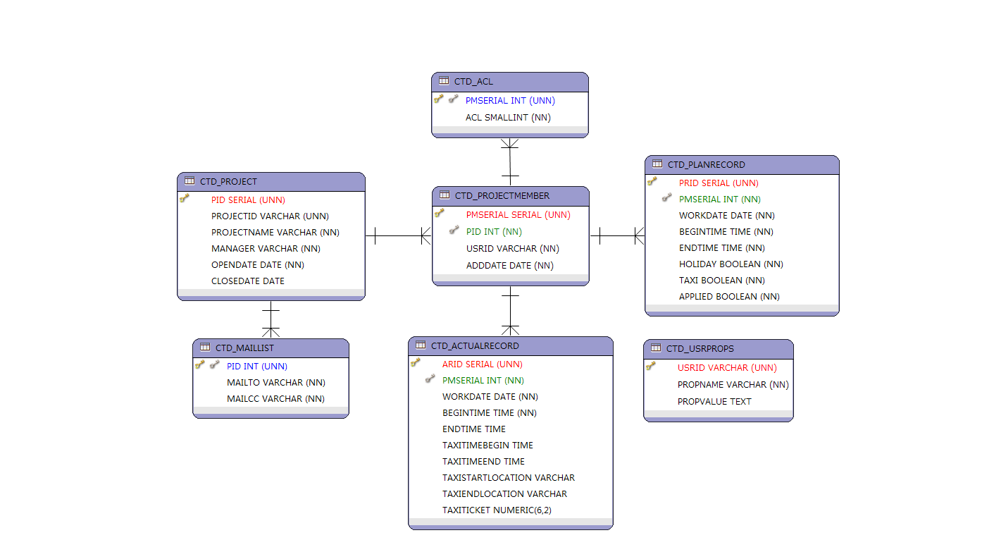
Database Design

Slide 7
About Client
Client has been coded in Javascript and HTML, and uses the Dojo framework.
Every UI component can used repeatedly.
Loaded necessary resources just when needed.
Further encapsulate methods access server, that can be more efficient for management.
Client code under the following directory:
code\WebContent\js\ctd\1.0 ├ request
├ Utils
├ Widget
┕ ctd.js

